Slide 1
Endocrine Case Study and Questions
NUR235

Slide 2
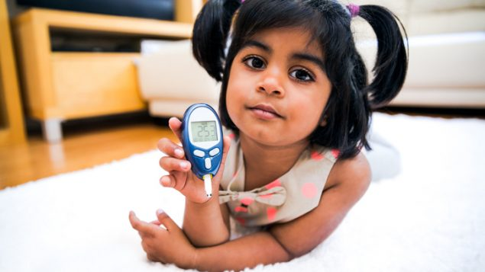
NGN Case Study #1

Slide 3
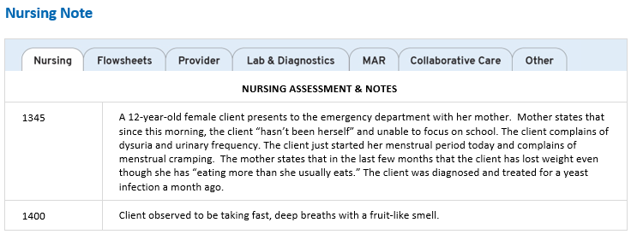
NGN Case Study #1: Recognize Cues

Slide 4
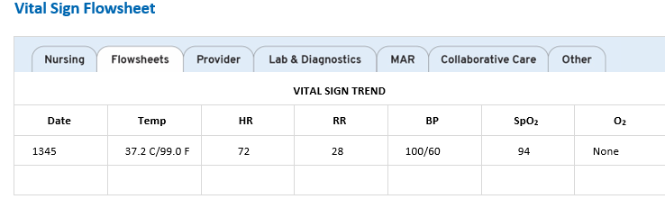
NGN Case Study #1: Recognize Cues
Notes:
nml HR, high RR, nml BP

Slide 5
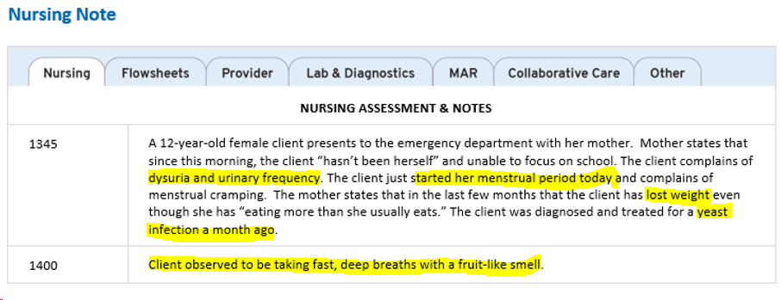
NGN Case Study #1: Recognize Cues
The nurse reviews the Nurses’ Notes and Vital Signs from 1345. Highlight the findings that need immediate follow-up:

Slide 6
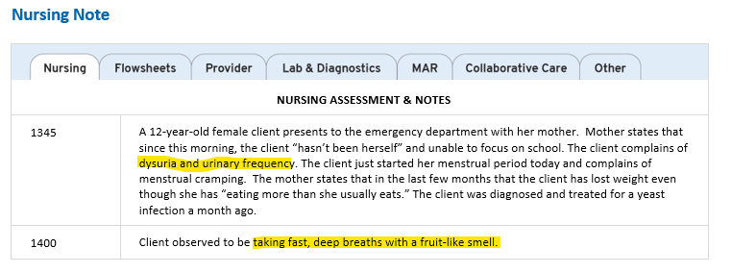
NGN Case Study #1: Recognize Cues
The nurse reviews the Nurses’ Notes and Vital Signs from 1345. Highlight the findings that need immediate followup:
Notes:
Clients with these abnormal findings require immediate follow up:
Dysuria and urinary frequency could be signs of a genitourinary complication (e.g., urinary tract infection).
Changes in respiratory assessment (e.g., fast, deep breaths with a fruit-like smell) could indicate respiratory insufficiency or compensation for an underlying metabolic disturbance.
Incorrect:
Menstrual period started today
A menstrual period is an expected finding in an adolescent female, but does not require immediate attention at this time. Although gastrointestinal upset can be linked to menstruation, other acute complications must first be ruled out.
Lost a few pounds even though she has been “eating more than what she usually eats”
Gradual weight loss over several months and changed eating habits could signal a health alteration. Although concerning, it is not the priority over more acute findings.
Diagnosed with yeast infection a month ago
Although this is valuable health history, it is not an immediate health concern and does not require attention at this time

Slide 7
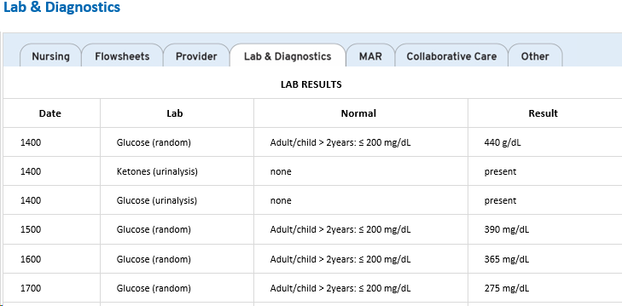
NGN Case Study #1: Analyze Cues
The nurse reviews laboratory data for this client:

Slide 8
NGN Case Study #1: Analyze Cues
For each client finding below, specify if the assessment finding is consistent with the disease process
of diabetes insipidus or diabetic ketoacidosis:
Assessment finding | Diabetes Insipidus | Diabetic Ketoacidosis
Ketonuria
Hyperglycemia
Excessive thirst
Excessive hunger
Frequent urination
Rapid, deep breaths
Fruit-like breath odor

Slide 9
NGN Case Study #1: Analyze Cues
For each client finding below, specify if the assessment finding is consistent with the disease process
of diabetes insipidus or diabetic ketoacidosis:
Assessment finding | Diabetes Insipidus | Diabetic Ketoacidosis
Ketonuria |  | X
Hyperglycemia |  | X
Excessive thirst | X | X
Excessive hunger |  | X
Frequent urination | X | X
Rapid, deep breaths |  | X
Fruit-like breath odor |  | X
Notes:
DKA:
Blood Glucose Level: Usually 250-800 mg/dL (11.1-44.4 mmol/L)
Ketonuria
Excessive thirst, hunger, urination (3P’s)
Rapid, shallow breaths (Kusmaal’s) with fruit-like breath odor
Diabetes insipidus (DI), and diabetic ketoacidosis (DKA), are all states of endocrine dysfunction characterized by increased urine output.
DI occurs when there is decreased antidiuretic hormone (ADH) secretion causing excessive urination and therefore, excessive thirst to compensate.
In DKA, an excess of unused, circulating glucose (i.e., hyperglycemia) causes a breakdown of fat for energy, forming acidic ketone bodies in the blood and creating an excessive hunger response (i.e., polyphagia) as the body attempts to provide fuel for the cells. Acidic ketones create a state of metabolic acidosis which the lungs attempt to correct by blowing off carbon dioxide, causing deep, rapid Kussmaul breaths and the fruit-like breath odor. Ketones are excreted into the urine (i.e., ketonuria) along with glucose, pulling water along with it (i.e., frequent urination). Fluid loss through urination causes dehydration and excessive thirst (i.e., polydipsia).

Slide 10
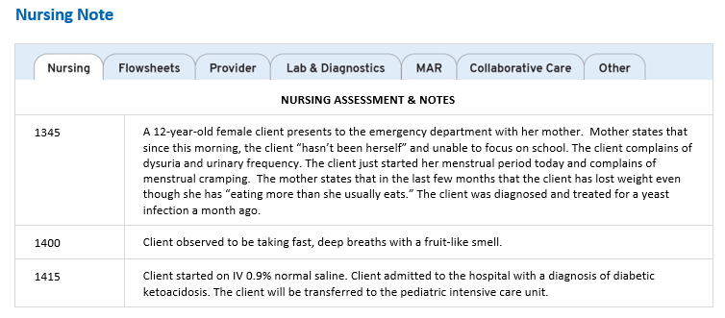
NGN Case Study #1: Prioritize hypotheses
Nurses’ Notes: 1415
The nurse reviews the Nurses’ Note from 1415. Fill in each blank in the following sentence:
The nurse should prioritize monitoring the client for: ______ , ________ , and _____________.
Word choices
Neuropathy
Retinopathy
Stroke
Severe dehydration
Cardiac arrest
Cerebral edema

Slide 11
NGN Case Study #1: Prioritize hypotheses
Nurses’ Notes: 1415
The nurse reviews the Nurses’ Note from 1415. Fill in each blank in the following sentence:
The nurse should prioritize monitoring the client for: severe dehydration, cerebral edema, and cardiac arrest.
Word choices
Neuropathy
Retinopathy
Stroke
Severe dehydration
Cardiac arrest
Cerebral edema
Notes:
Diabetic ketoacidosis (DKA) is a life threatening complication of type 1 diabetes. Osmotic diuresis in DKA causes polyuria and without rapid fluid replacement can lead to severe dehydration. Acidosis and dehydration create electrolyte imbalances, placing the client at risk for deadly arrhythmias and cardiac arrest.
When administering IV fluids to treat DKA, the sudden increase in intravascular fluid can quickly move fluid into the cells. If fluid and insulin are replaced too quickly, there is an increased risk of swelling in the brain (i.e., cerebral edema). Cerebral edema is more commonly seen in pediatric clients.
Therefore, the nurse should prioritize monitoring the client for cardiac arrest, cerebral edema, and severe dehydration.
Incorrect:
Stroke, Neuropathy, Retinopathy
Diabetes can damage nerves, causing decreased sensation and pain (i.e., neuropathy), and microvascular damage to the vessels of the retina (i.e. retinopathy) with loss of vision. Over time, hyperglycemia can damage vasculature, increasing the risk of atherosclerosis, myocardial infarction, and stroke. These chronic complications are not immediately life threatening.
Urinary tract infection
Glucose in the urine (i.e., glycosuria) increases bacterial and fungal growth, increasing risk for UTIs. Although a concern, bacteria takes time to grow, so this is not the highest risk at this time.

Slide 12
NGN Case Study #1: Generate Solutions
For each body system below, choose the best potential nursing interventions that would be considered for this client:
Body System | Choice 1 | Choice 2 | Choice 3
Nervous | Monitor for changes in level of consciousness | Administer prescribed seizure medications | Prepare for MRI
Cardiovascular | Prepare for cardioversion | Place client on cardiac monitor | Assess for deep vein thrombosis (DVT) q 4 hours
Respiratory | Prepare for continuous positive airway pressure (CPAP) | Place client in semi-Fowler’s position | Monitor arterial blood gases
Endocrine | Administer continuous IV regular insulin | Administer IM glucagon | Monitor blood glucose 4x/day

Slide 13
NGN Case Study #1: Generate Solutions
For each body system below, choose the best potential nursing interventions that would be considered for this client:
Body System | Choice 1 | Choice 2 | Choice 3
Nervous | Monitor for changes in level of consciousness | Administer prescribed seizure medications | Prepare for MRI
Cardiovascular | Prepare for cardioversion | Place client on cardiac monitor | Assess for deep vein thrombosis (DVT) q 4 hours
Respiratory | Prepare for continuous positive airway pressure (CPAP) | Place client in semi- Fowler’s position | Monitor arterial blood gases
Endocrine | Administer continuous IV regular insulin | Administer IM glucagon | Monitor blood glucose every 4 hours
Notes:
Interventions for DKA are aimed at monitoring for complications and managing blood glucose levels.
Nervous system:
Monitor for changes in level of consciousness that can indicate electrolyte imbalances or cerebral edema.
Incorrect:
Preparing for MRI and administering antiepileptic medication are unnecessary, as the client’s mental status changes are caused by metabolic disturbances, not a neurologic condition.
Endocrine system:
Administer continuous IV regular insulin to quickly manage blood glucose levels and titrate for changes.
Incorrect:
Administering IM glucagon. IM glucagon may be indicated for hypoglycemia, not hyperglycemia
Blood glucose monitoring is required hourly, not every 2 hours, during IV insulin infusion to determine titration and monitor for hypoglycemia.
Respiratory system:
Monitor ABGs to assess severity of acidosis and response to treatment.
Incorrect:
Preparing for CPAP and placing client in semi Fowler’s are not indicated if the client is adequately oxygenated.
Cardiovascular system:
Connect the client to a cardiac monitor to assess ECG changes caused by electrolyte imbalances.
Incorrect:
Assessing for DVT every 4 hours is unnecessary if the client is low risk for DVT (e.g., no malignancy or recent surgery).
Preparing for cardioversion is unnecessary and treatment indicated for atrial fibrillation or SVT

Slide 14
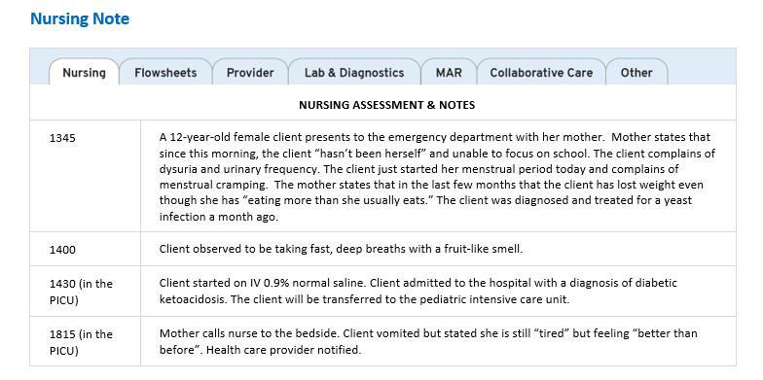
NGN Case Study #1: Take Action
The nurse reviews the updated Laboratory Results from 1500 through 1800, and Nurses’ Notes from 1430 and 1815.
Which actions should the nurse take at this time?
Potential Interventions | Completed Interventions
Administer IV labetalol
Administer IV potassium
Prepare for cardioversion
Obtain a troponin level
Stop the IV insulin infusion
Administer IV ondansetron
Start subcutaneous insulin
Obtain a basic metabolic panel
Start IV dextrose 5% in sodium chloride 0.9%

Slide 15
NGN Case Study #1: Take Action
The nurse reviews the updated Laboratory Results from 1500 through 1700, and Nurses’ Notes from 1430 and 1815.
Which actions should the nurse take at this time?
Potential Interventions | Completed Interventions
Administer IV labetalol
Administer IV potassium
Prepare for cardioversion
Obtain a troponin level
Stop the IV insulin infusion
Administer IV ondansetron | X
Start subcutaneous insulin
Obtain a basic metabolic panel | X
Start IV dextrose 5% in sodium chloride 0.9% | X
Notes:
Hyperkalemia occurs in diabetic ketoacidosis when high serum osmolality (e.g., from hyperglycemia) causes hydrogen ions to enter the cell in exchange for potassium. After administering IV fluids and insulin, insulin drives potassium back into the intracellular space, which may precipitate hypokalemia.
Once blood glucose is between 250-300 mg/dL (13.9-16.7 mmol/L), the nurse should start IV fluids containing 5% to 10% dextrose, like dextrose 5% in sodium chloride 0.9%, to maintain normal glucose levels and prevent hypoglycemia.
Administer IV ondansetron to treat nausea.
Obtain a basic metabolic panel to monitor potassium and other electrolytes
Incorrect:
Start subcutaneous insulin, Stop the IV insulin infusion
IV insulin is discontinued once glucose levels are low enough to utilize subcutaneous insulin, nausea and vomiting have resolved, and the client can tolerate oral intake.
Obtain a troponin level, Administer IV labetalol, Prepare for cardioversion
Troponin levels are not indicated for this client, as the ECG changes are caused by hypokalemia rather than coronary ischemia. Cardioversion and IV beta blockers are indicated in unstable tachyarrhythmias (e.g., atrial fibrillation).
Administer IV potassium
The nurse must confirm hypokalemia by checking a BMP before administering potassium.
Key Takeaway:
Only administer potassium once hypokalemia is confirmed with a BMP.

Slide 16
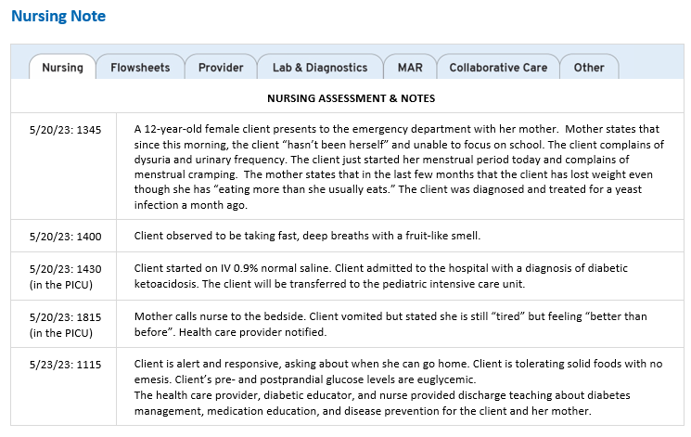
NGN Case Study #1: Evaluate Outcomes

Slide 17
NGN Case Study #1: Evaluate Outcomes
The nurse and diabetic educator have provided discharge teaching to the client and her mother. The nurse has reviewed the Nurses’ Note from Day 3 at 1115. Which statements reflect understanding or need further education (no understanding)?
.
Client statements | Understanding | No understanding
“If I am sick and not eating, I should skip my insulin dose.”
“Healthy diet and exercise changes can reverse my Type 1 diabetes.”
“I should bring snacks when I go to dance class or tennis practice.”
“If I feel super tired for no reason, it may be a good idea to check my blood sugar.”
“I should foods like whole wheat bread and fruits rather than white bread and jam.”
“I need to have a snack if I feel sweaty, nauseous, and my heart is beating fast.”
“If my blood sugar is under 60 mg/dl, I can drink a ½ can of diet soda to increase my sugar.”
“When I throw out my insulin needle, I should put the cap back on the needle before I throw it in the trash.”

Slide 18
NGN Case Study #1: Evaluate Outcomes
The nurse and diabetic educator have provided discharge teaching to the client and her mother. The nurse has reviewed the Nurses’ Note from Day 3 at 1115. Which statements reflect understanding or need further education (no understanding)?
.
Client statements | Understanding | No understanding
“If I am sick and not eating, I should skip my insulin dose.” |  | X
“Healthy diet and exercise changes can reverse my Type 1 diabetes.” |  | X
“I should bring snacks when I go to dance class or tennis practice.” | X
“If I feel super tired for no reason, it may be a good idea to check my blood sugar.” | X
“I should foods like whole wheat bread and fruits rather than white bread and jam.” | X
“I need to have a snack if I feel sweaty, nauseous, and my heart is beating fast.” | X
“If my blood sugar is under 60 mg/dl, I can drink a ½ can of diet soda to increase my sugar.” |  | X
“When I throw out my insulin needle, I should put the cap back on the needle before I throw it in the trash.” |  | X
Notes:
Teaching is effective if the client demonstrates an understanding of these teaching points:
Manage hypoglycemia by checking blood sugar and eating a snack when feeling hypoglycemic
Bring snacks during physical activities to prevent hypoglycemia after exercise
Choose complex carbohydrates and whole fruits over simple carbohydrates and refined sugars. Simple carbohydrates from white bread and sugary foods quickly increase blood sugar, while complex carbohydrates and whole fruits with fiber are absorbed more slowly.
No understanding:
In type 1 diabetes, the insulin-producing pancreatic beta cells are permanently damaged and the pancreas can no longer produce any insulin. Clients with type 1 diabetes require frequent exogenous insulin. Healthy diet and exercise can help manage glucose levels but cannot restore pancreatic function.
Managing diabetes during illness requires clients to take insulin even when not eating. Infection and illness cause a stress-induced hyperglycemia that requires insulin to treat.
Hypoglycemic clients should consume a ½ cup of non-diet soda or juice which is higher in sugar to quickly increase blood sugar
Clients should not recap needles or throw needles in a trash bag because of possible injury [Choice 8]. Place sharps in puncture resistant containers and dispose following community guidelines.
Key Takeaway:
Clients with type 1 diabetes should:
Monitor blood glucose
Bring snacks when exercising
Understand signs of hypoglycemia
Drink ½ cup of a high sugar beverage when hypoglycemic
Follow a low carbohydrate and low sugar diet
Properly dispose of insulin needles

Slide 19
More questions…

Slide 20
The nurse is seeing a new client in the clinic who reports polyuria and polydipsia. These conditions are indicative of which endocrine disorder?
a. Syndrome of inappropriate antidiuretic hormone (SIADH) secretion
b. Hypopituitarism
c. Diabetes insipidus (DI)
d. Precocious puberty
Notes:
Answer: c

Slide 21
The nurse is caring for a child diagnosed with low functioning parathyroid. Which is a treatment goal of a child with hypoparathyroidism?
a. Maintain the child's calcium level at a normal level with calcium replacement as prescribed.
b. Assure the parents have a plan in place for periods of low glucose levels if noted.
c. Provide the child and parent with a referral to a pediatric gastrointestinal specialist.
d. Provide the parents a specific dietary plan for high-phosphorus foods to be eaten.
Notes:
Answer: a

Slide 22
A nurse is providing teaching to a 13-year-old client who has type 1 diabetes mellitus. Which of the following client statements indicates an understanding of diabetes mellitus management?
“I will need to avoid snacks between meals.”
“I should check my blood glucose levels more often when I am sick.”
“I will need to limit my exercise to 1 hour per day.”
“I should consume 30 g of simple carbohydrates if I feel shaky.”
Notes:
Answer: b

Slide 23
The nurse is caring for a child with type 1 diabetes mellitus. The nurse notes the child is drowsy, has flushed cheeks and dry lips, a fruity smell to the breath, and there has been an increase in the rate and depth of the child's respirations. Which prescription from the primary health care provider will the nurse question?
a. intravenous fluid replacement
b. regular insulin IV
c. serum ketone testing
d. monitor glucose level every 3 hour
Notes:
Answer: d

Slide 24
A newborn has just been diagnosed with phenylketonuria (PKU). The physician and nurse have taught the parents about the defect. What statement by the parents demonstrates a need for further instruction?
a. "Nothing can be done medically to manage this condition."
b. "PKU can lead to severe damage to the central nervous system."
c. "Both of us must have carried the gene for PKU."
d. "My child will have this diagnosis for the rest of their life.”
Notes:
Answer: a

